Slide 1
V1.1 2021
Manual for Actual Expense Update
FI SUSKO PPC, March 2023

Slide 2
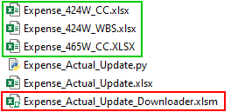
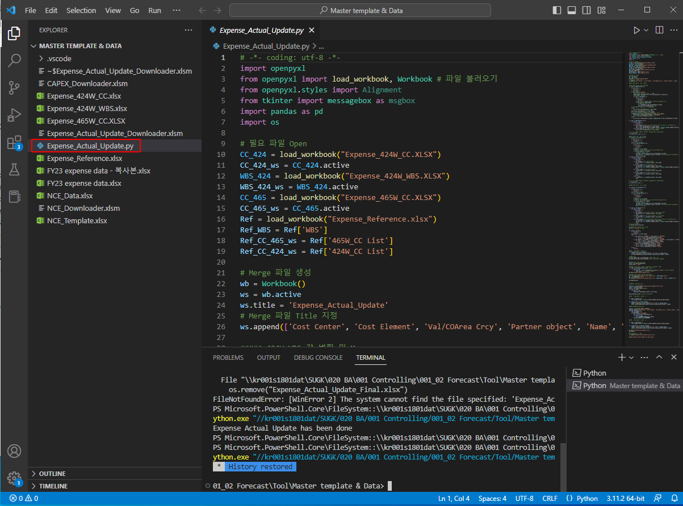


Overall Process of Actual Expense Update
SAP Data Download
P41: Excel Macro (SAP script)
Data Convert& Merge
AP0: Manually or Excel Macro (SAP script)
Copy & past manually
Update Master File
Visual Studio Code (running Python code)
Add special item (G/L acct 6299)

Slide 3
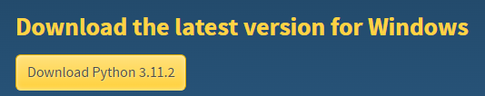
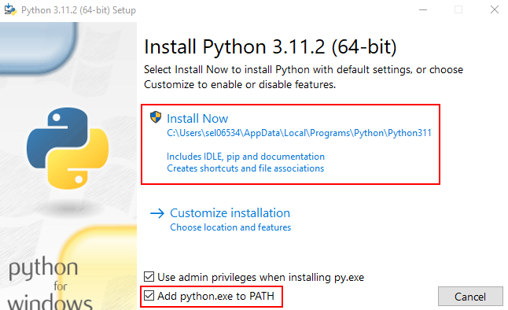
Basic Setting_(1) Install Python
1. Python (https://www.python.org/)
Computer programming language

Slide 4

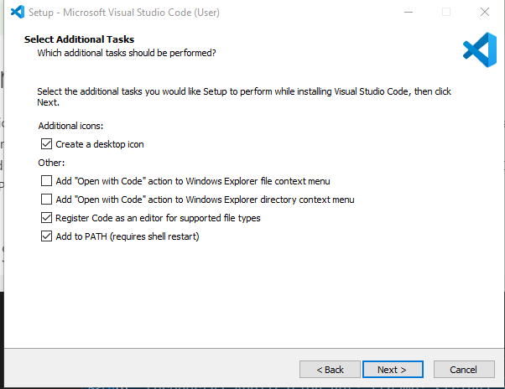
Basic Setting_(2) Install Visual Studio Code
2. Visual Studio Code (https://code.visualstudio.com/)
Source code editor
Source code: human-readable computer instructions written by programmers

Slide 5
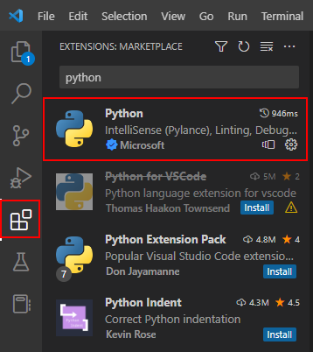
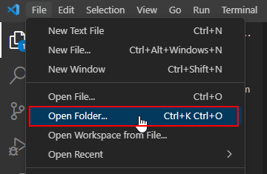

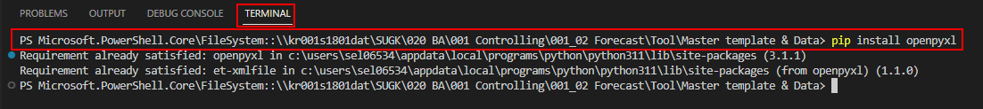
Basic Setting_(2) Install Visual Studio Code
Step 1. Install Extension “Python”
Step 2. Open folder:\\kr001s1801dat\SUGK\020 BA\001 Controlling\001_02 Forecast\Tool\Master template & Data
Step 3. Open Terminal
Step 4. Install 3 types of xx (openpyxl / pandas / os )
pip install openyxl / pip install pandas / pip install os
*caution: letter “pip” must be small letter

Slide 6
Basic Setting_(3) Save Layout for SAP P41
Layout 시트에 있는 것과 동일하게 저장하기

Slide 7
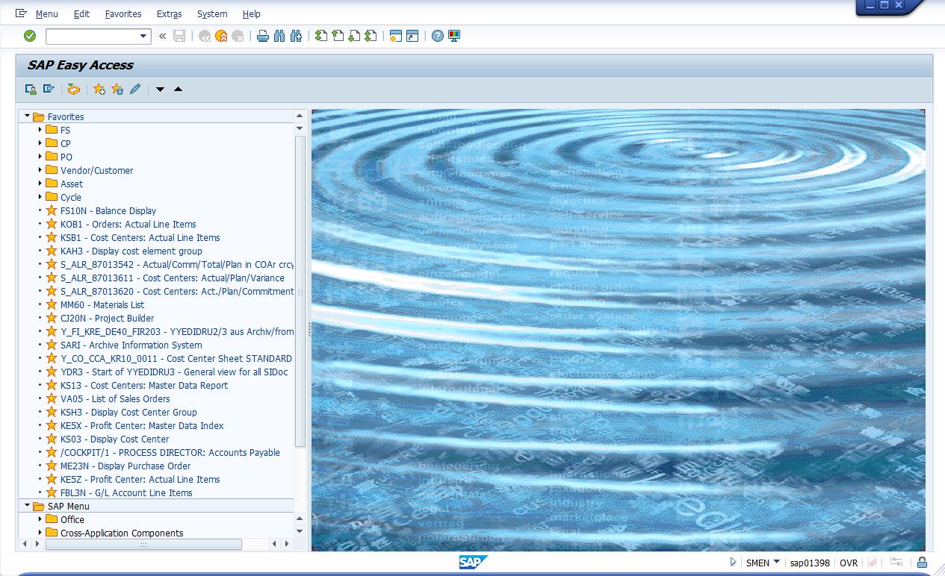
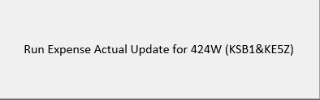
Step 1. SAP Data Download_P41 (424W)
\\kr001s1801dat\SUGK\020 BA\001 Controlling\001_02 Forecast\Tool\Master template & Data\Expense_Actual_Update_Downloader.xlsm
Close all and Open a new window of SAP P41
Click the icon to run
Check the message box after download done

Slide 8
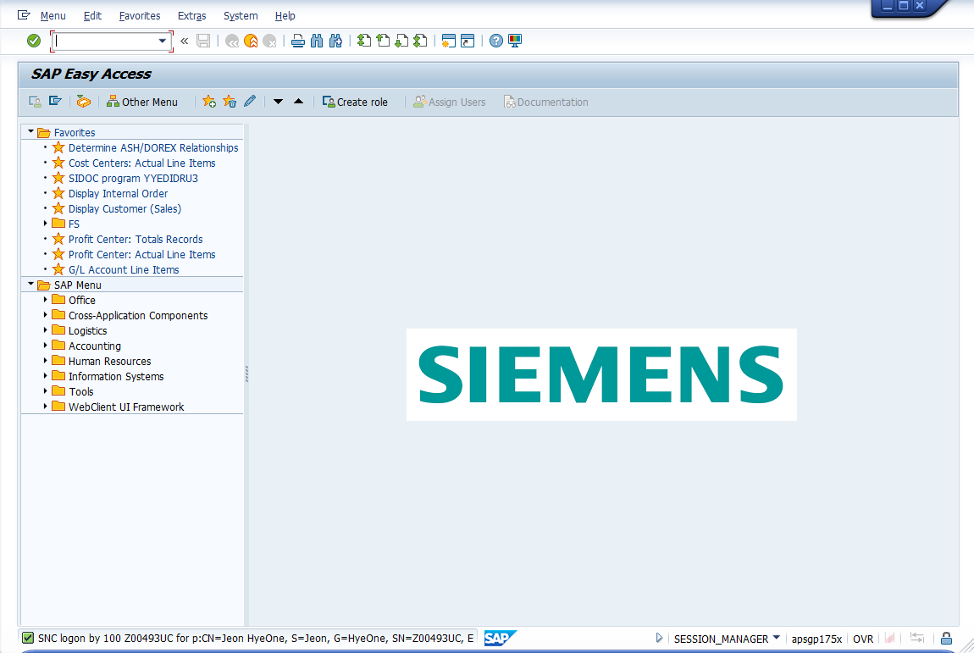
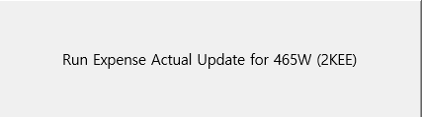
Step 1. SAP Data Download_AP0 (465W)
\\kr001s1801dat\SUGK\020 BA\001 Controlling\001_02 Forecast\Tool\Master template & Data\Expense_Actual_Update_Downloader.xlsm
Close all and Open a new window of SAP AP0
Click the icon to run
Check the message box after download done
*Special role is required for AP0 to run Excel Macro. If you don’t have the role, please download data manually and overwrite to the below file.
\\kr001s1801dat\SUGK\020 BA\001 Controlling\001_02 Forecast\Tool\Master template & Data\Expense_465W_CC.XLSX

Slide 9
Step 2. SAP Data Download_P41 (424W)
\\kr001s1801dat\SUGK\020 BA\001 Controlling\001_02 Forecast\Tool\Master template & Data\Expense_Actual_Update_Downloader.xlsm
Close all and Open a new window of SAP P41
Click the icon to run
Check the message box after download done

Slide 10
Document history and contact information
Version 1.1
Release date 2021 – 10 – 27
Author HyeOne Jeon
Updated illustration style
Design support of Siemens Healthineers branding@siemens-healthineers.com

